Slide 1

Differentially Private Measures of Statistical Heterogeneity for Vectors
Mary Scott (supervisors: Graham Cormode and Carsten Maple)
WPCCS 2023 (Friday 24th March)

Slide 2
Federated Learning/Analytics is the setting.
Notes:
An example of useful medical information is statistics about various cancer diagnoses, including likelihood of developing different types, prognosis, and the effectiveness of particular drugs in increasing life expectancy. Of course the information used to collect these statistics is very personal and sensitive; you would not want your boss or neighbour for example to find out specific information about your medical history.

Slide 3
Federated Learning

Slide 4
Federated Learning
Central server

Slide 5
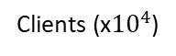
Federated Learning
Central server
Clients (x${10}^{4}$)

Slide 6
Federated Learning
I have a model
Central server
Clients (x${10}^{4}$)

Slide 7
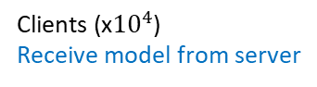
Send out model to clients
Federated Learning
Central server
Clients (x${10}^{4}$)
Receive model from server

Slide 8
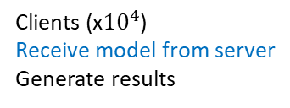
Send out model to clients
Federated Learning
Central server
Clients (x${10}^{4}$)
Receive model from server
Generate results

Slide 9
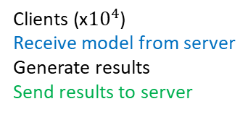
Send out model to clients
Receive results from clients
Federated Learning
Central server
Clients (x${10}^{4}$)
Receive model from server
Generate results
Send results to server

Slide 10
Send out model to clients
Receive results from clients
Federated Learning
Aggregation
Analysis
Improvements to model
Central server
Clients (x${10}^{4}$)
Receive model from server
Generate results
Send results to server

Slide 11
Federated Learning
I have an improved model
Central server
Clients (x${10}^{4}$)

Slide 12
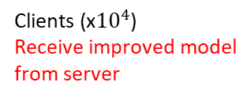
Send out improved model to clients
Federated Learning
Central server
Clients (x${10}^{4}$)
Receive improved model
from server

Slide 13
Federated Analytics?
Central server
Clients (x${10}^{4}$)

Slide 14
Federated Analytics?
Central server
Clients (x${10}^{4}$)

Slide 15
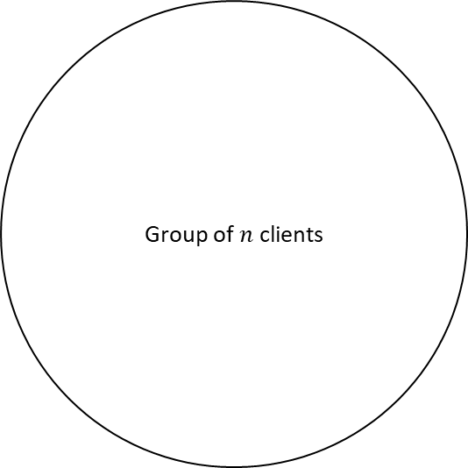
Federated Analytics?
Group of $n$ clients
Clients (x${10}^{4}$)

Slide 16
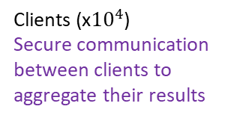
Federated Analytics?
Clients (x${10}^{4}$)
Secure communication
between clients to
aggregate their results

Slide 17
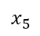
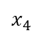
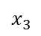
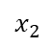
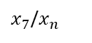
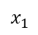
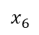
Federated Analytics?
$$x_{1}$$
$$x_{2}$$
$x_{7}$/$x_{n}$
$$x_{3}$$
$$x_{6}$$
$$x_{4}$$
Clients (x${10}^{4}$)
Secure communication
between clients to
aggregate their results
$$x_{5}$$

Slide 18
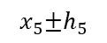
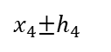
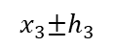
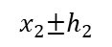
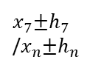
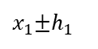
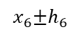
Federated Analytics?
$x_{1}$±$h_{1}$
$$x_{2}\text{±}h_{2}$$
$x_{7}$±$h_{7}$
/$x_{n}\text{±}h_{n}$
$$x_{3}\text{±}h_{3}$$
$$x_{6}\text{±}h_{6}$$
$x_{4}$±$h_{4}$
Clients (x${10}^{4}$)
Secure communication
between clients to
aggregate their results
$$x_{5}\text{±}h_{5}$$

Slide 19
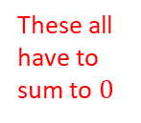
Not really Differential
Privacy as does not
satisfy definition
Federated Analytics?
$x_{1}$±$h_{1}$
$$x_{2}\text{±}h_{2}$$
$x_{7}$±$h_{7}$
/$x_{n}\text{±}h_{n}$
These all have to sum to $0$
$$x_{3}\text{±}h_{3}$$
$$x_{6}\text{±}h_{6}$$
$x_{4}$±$h_{4}$
Clients (x${10}^{4}$)
Secure communication
between clients to
aggregate their results
$$x_{5}\text{±}h_{5}$$

Slide 20
Federated Analytics?
Further measurements, analyses and improvements (beyond Federated Learning)
Clients (x${10}^{4}$)
Secure communication
between clients to
aggregate their results

Slide 21
Statistical
Heterogeneity?
Clients (x${10}^{4}$)

Slide 22
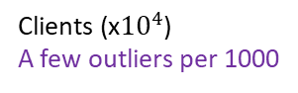
Statistical
Heterogeneity?
Clients (x${10}^{4}$)
A few outliers per 1000

Slide 23
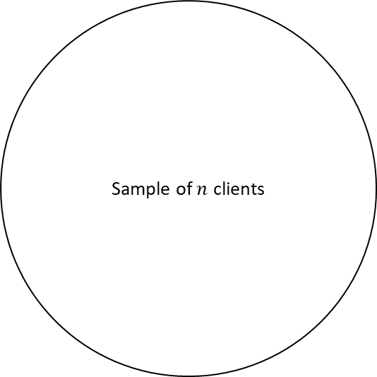
Statistical
Heterogeneity?
Sample of $n$ clients
Clients (x${10}^{4}$)
A few outliers per 1000

Slide 24
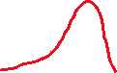
Each sample
Statistical
Heterogeneity?
Sample of $n$ clients
Clients (x${10}^{4}$)
A few outliers per 1000

Slide 25
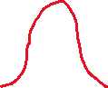
Each sample
Statistical
Heterogeneity?
Sample of $n$ clients
Overall
Clients (x${10}^{4}$)
A few outliers per 1000

Slide 26
Each sample
Statistical
Heterogeneity?
Sample of $n$ clients
“More than due to randomness”
Overall
Clients (x${10}^{4}$)
A few outliers per 1000

Slide 27
Still hard to explain Statistical Heterogeneity.

Slide 28
Still hard to explain Statistical Heterogeneity.
So will use an analogy inspired by the first paper where Federated Analytics and Statistical Heterogeneity are combined.
FedACS

Slide 29
Still hard to explain Statistical Heterogeneity.
So will use an analogy inspired by the first paper where Federated Analytics and Statistical Heterogeneity are combined.
FedACS
Analytics-driven
Federated
Client
Selection

Slide 30


Still hard to explain Statistical Heterogeneity.
So will use an analogy inspired by the first paper where Federated Analytics and Statistical Heterogeneity are combined.
FedACS
Analytics-driven
Federated
Client
Selection

Slide 31






Still hard to explain Statistical Heterogeneity.
So will use an analogy inspired by the first paper where Federated Analytics and Statistical Heterogeneity are combined.
FedACS
Why not use lorries?
Analytics-driven
Federated
Client
Selection

Slide 32
Statistical Heterogeneity: using the “lorry” analogy

Slide 33
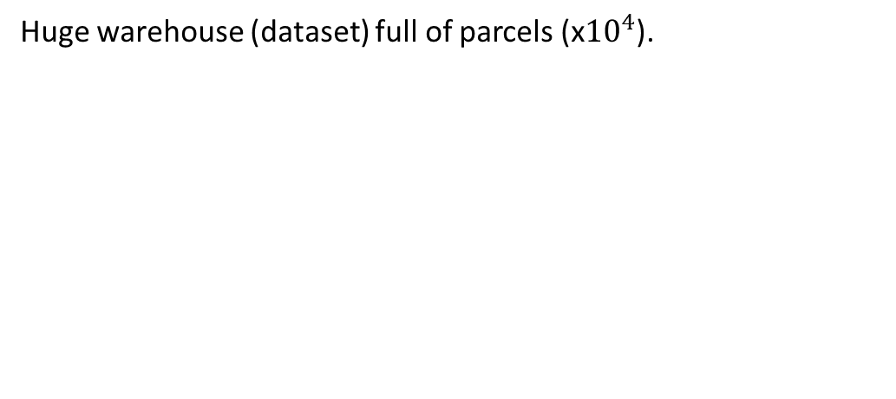
Statistical Heterogeneity: using the “lorry” analogy
Huge warehouse (dataset) full of parcels (x${10}^{4}$).

Slide 34
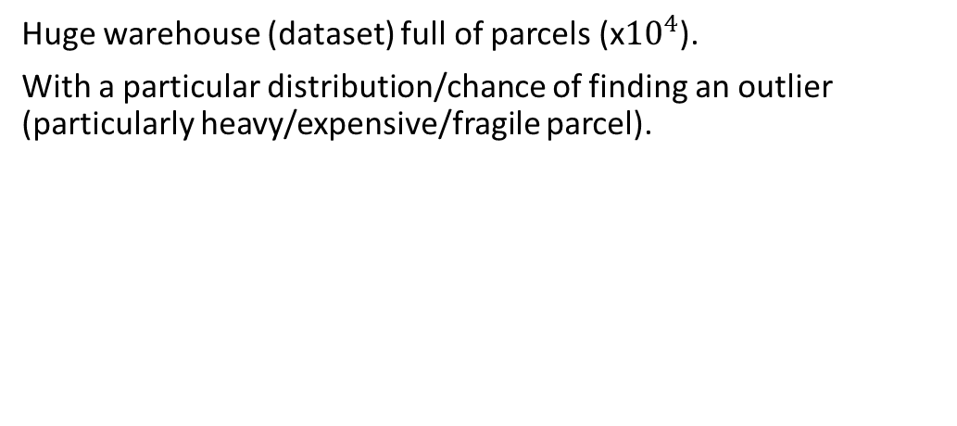
Statistical Heterogeneity: using the “lorry” analogy
Huge warehouse (dataset) full of parcels (x${10}^{4}$).
With a particular distribution/chance of finding an outlier (particularly heavy/expensive/fragile parcel).

Slide 35
Statistical Heterogeneity: using the “lorry” analogy
Each lorry takes a sample of this warehouse.

Slide 36
Statistical Heterogeneity: using the “lorry” analogy
Each lorry takes a sample of this warehouse.

Slide 37
Statistical Heterogeneity: using the “lorry” analogy
Each lorry takes a sample of this warehouse.
Sample (x100) expected to be slightly different for each lorry

Slide 38
Statistical Heterogeneity: using the “lorry” analogy
Each lorry takes a sample of this warehouse.
Statistical Heterogeneity: observe differences greater than these expectations, e.g. more/fewer outlier parcels.
Sample (x100) expected to be slightly different for each lorry

Slide 39
Statistical Heterogeneity: using the “lorry” analogy
Keep getting these “outlier lorries” at a greater frequency than expected/normal.

Slide 40
Statistical Heterogeneity: using the “lorry” analogy
Keep getting these “outlier lorries” at a greater frequency than expected/normal.

Slide 41
Statistical Heterogeneity: using the “lorry” analogy
Keep getting these “outlier lorries” at a greater frequency than expected/normal.
Can measure Statistical Heterogeneity by:
weight
volume/surface area
time element (e.g. when the package was ordered)
price

Slide 42
Statistical Heterogeneity: using the “lorry” analogy
Cannot expect every lorry to have same/similar distribution of parcels.

Slide 43
Statistical Heterogeneity: using the “lorry” analogy
Cannot expect every lorry to have same/similar distribution of parcels.
But they all have to handle all types of loads.

Slide 44
Statistical Heterogeneity: using the “lorry” analogy
Cannot expect every lorry to have same/similar distribution of parcels.
But they all have to handle all types of loads.

Slide 45
Statistical Heterogeneity: using the “lorry” analogy
Cannot expect every lorry to have same/similar distribution of parcels.
But they all have to handle all types of loads.
Same applies to an algorithm!

Slide 46
Statistical Heterogeneity for an algorithm

Slide 47
Statistical Heterogeneity for an algorithm
Needs to handle the data no matter the statistical heterogeneity.

Slide 48
Statistical Heterogeneity for an algorithm
Needs to handle the data no matter the statistical heterogeneity.
First step: how to measure the statistical heterogeneity?

Slide 49
Statistical Heterogeneity for an algorithm
Needs to handle the data no matter the statistical heterogeneity.
First step: how to measure the statistical heterogeneity?
Historically:

Slide 50
Statistical Heterogeneity for an algorithm
Needs to handle the data no matter the statistical heterogeneity.
First step: how to measure the statistical heterogeneity?
Historically:
Statistical Heterogeneity

Slide 51
Statistical Heterogeneity for an algorithm
Needs to handle the data no matter the statistical heterogeneity.
First step: how to measure the statistical heterogeneity?
Historically:
Accuracy of algorithm in Federated Learning/Analytics
Statistical Heterogeneity

Slide 52
Statistical Heterogeneity for an algorithm
Needs to handle the data no matter the statistical heterogeneity.
First step: how to measure the statistical heterogeneity?
Historically:
So want to adjust algorithm based on measured SH.
Accuracy of algorithm in Federated Learning/Analytics
Statistical Heterogeneity

Slide 53
Statistical Heterogeneity for an algorithm
Needs to handle the data no matter the statistical heterogeneity.
First step: how to measure the statistical heterogeneity?
Historically:
So want to adjust algorithm based on measured SH.
Or change how samples are taken.
Accuracy of algorithm in Federated Learning/Analytics
Statistical Heterogeneity

Slide 54
Skewness tolerance for a lorry

Slide 55
Skewness tolerance for a lorry
Have certain tolerance for number of large/fragile/expensive packages.

Slide 56
Skewness tolerance for a lorry
Have certain tolerance for number of large/fragile/expensive packages.
Problem could be:

Slide 57
Skewness tolerance for a lorry
Have certain tolerance for number of large/fragile/expensive packages.
Problem could be:
limited capacity

Slide 58
Skewness tolerance for a lorry
Have certain tolerance for number of large/fragile/expensive packages.
Problem could be:
limited capacity
increased chance of breakages

Slide 59
Skewness tolerance for a lorry
Have certain tolerance for number of large/fragile/expensive packages.
Problem could be:
limited capacity
increased chance of breakages
increased damages if accident were to occur

Slide 60
Skewness tolerance for a lorry
Have certain tolerance for number of large/fragile/expensive packages.
Problem could be:
limited capacity
increased chance of breakages
increased damages if accident were to occur
limited insurance

Slide 61
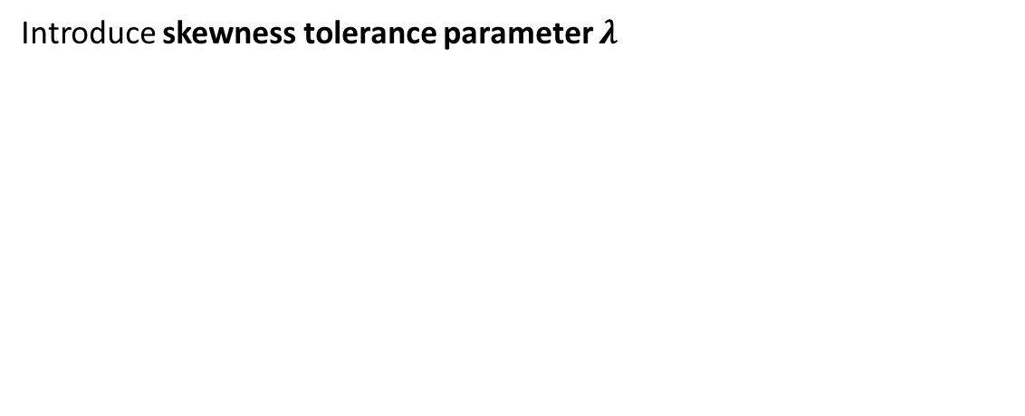
Skewness tolerance for a lorry
Introduce skewness tolerance parameter $λ$

Slide 62
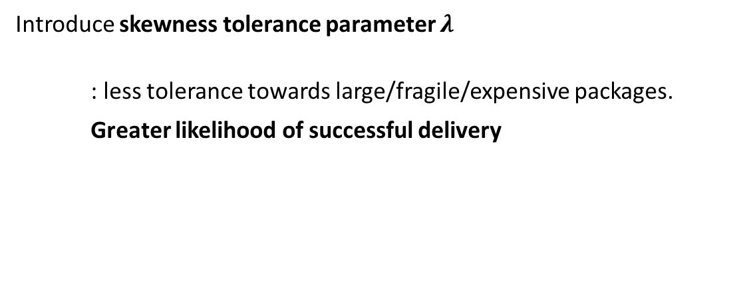
Skewness tolerance for a lorry
Introduce skewness tolerance parameter $λ$
: less tolerance towards large/fragile/expensive packages.
Greater likelihood of successful delivery

Slide 63
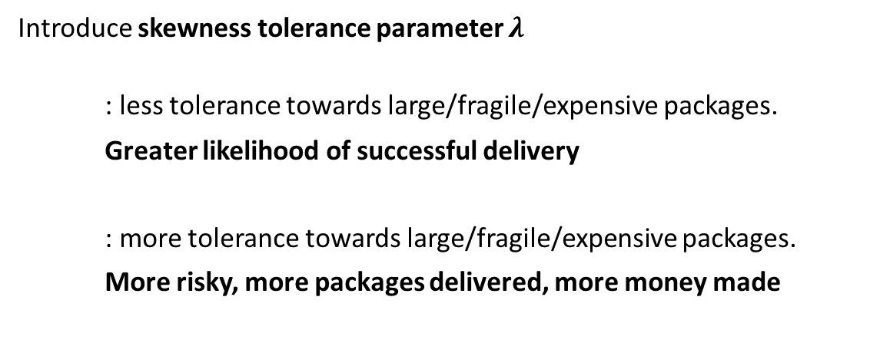
Skewness tolerance for a lorry
Introduce skewness tolerance parameter $λ$
: less tolerance towards large/fragile/expensive packages.
Greater likelihood of successful delivery
: more tolerance towards large/fragile/expensive packages.
More risky, more packages delivered, more money made

Slide 64
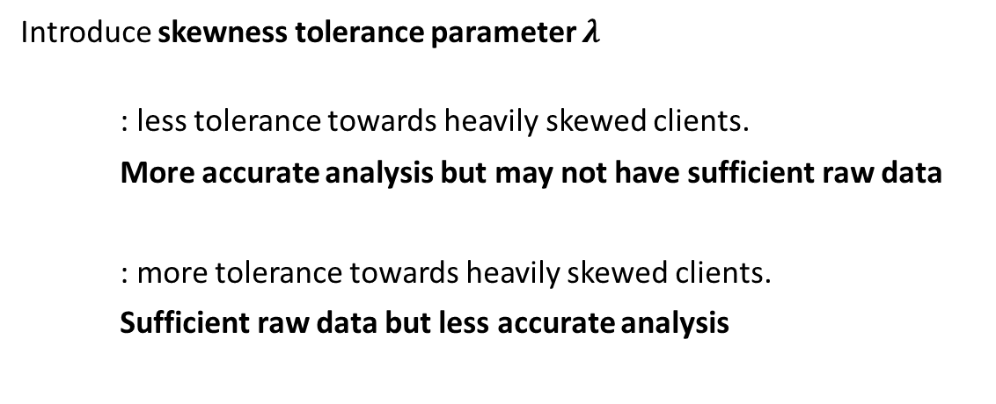
Skewness tolerance for an algorithm
Introduce skewness tolerance parameter $λ$
: less tolerance towards heavily skewed clients.
More accurate analysis but may not have sufficient raw data
: more tolerance towards heavily skewed clients.
Sufficient raw data but less accurate analysis

Slide 65
Skewness tolerance for an algorithm
Combats problem of statistical heterogeneity in federated analytics.

Slide 66
Skewness tolerance for an algorithm
Combats problem of statistical heterogeneity in federated analytics.
Extend to consider:

Slide 67
Skewness tolerance for an algorithm
Combats problem of statistical heterogeneity in federated analytics.
Extend to consider:
privacy

Slide 68
Skewness tolerance for an algorithm
Combats problem of statistical heterogeneity in federated analytics.
Extend to consider:
privacy
computational cost

Slide 69
Skewness tolerance for an algorithm
Combats problem of statistical heterogeneity in federated analytics.
Extend to consider:
privacy
computational cost
Represented by risk and fuel respectively in the lorry analogy.

Slide 70
Improvements to FedACS

Slide 71
Improvements to FedACS
PAIRWISE comparison method to eliminate clients beyond certain skewness.

Slide 72
Improvements to FedACS
PAIRWISE comparison method to eliminate clients beyond certain skewness.
Need to compare:
A
B
C
D

Slide 73
Improvements to FedACS
PAIRWISE comparison method to eliminate clients beyond certain skewness.
Need to compare:
A with B
A with C
A with D
B with C
B with D etc.
A
B
C
D

Slide 74
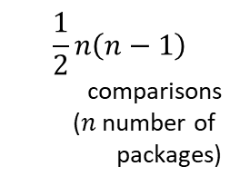
Improvements to FedACS
PAIRWISE comparison method to eliminate clients beyond certain skewness.
Need to compare:
A with B
A with C
A with D
B with C
B with D etc.
A
B
$$\frac{1}{2}n\left(n−1\right)$$
comparisons
($n$ number of packages)
C
D

Slide 75
Improvements to FedACS
More efficient way to do this.

Slide 76
Improvements to FedACS
More efficient way to do this.
SINGLE-client measure without relying on the presence of others.

Slide 77
Improvements to FedACS
More efficient way to do this.
SINGLE-client measure without relying on the presence of others.
Dispersion: how far away are the values (in general) from the mean?

Slide 78
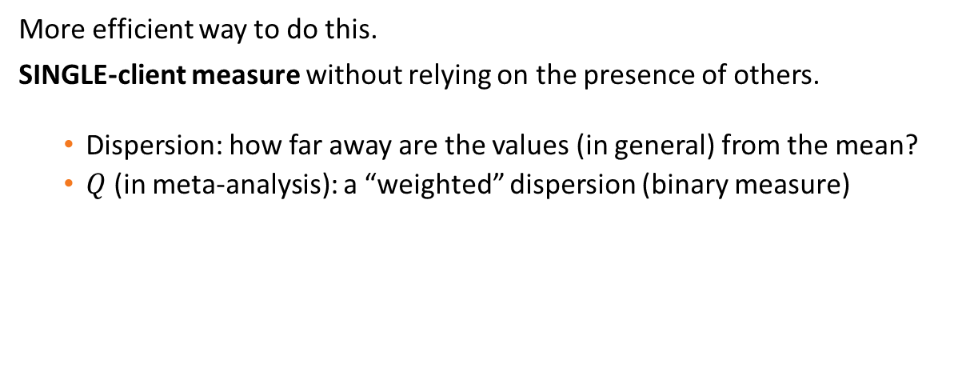
Improvements to FedACS
More efficient way to do this.
SINGLE-client measure without relying on the presence of others.
Dispersion: how far away are the values (in general) from the mean?
$Q$ (in meta-analysis): a “weighted” dispersion (binary measure)

Slide 79
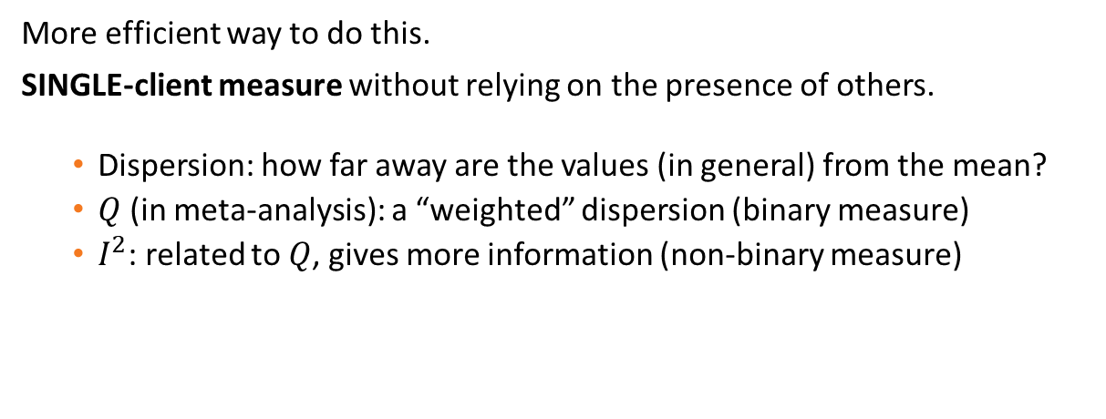
Improvements to FedACS
More efficient way to do this.
SINGLE-client measure without relying on the presence of others.
Dispersion: how far away are the values (in general) from the mean?
$Q$ (in meta-analysis): a “weighted” dispersion (binary measure)
$I^{2}$: related to $Q$, gives more information (non-binary measure)

Slide 80
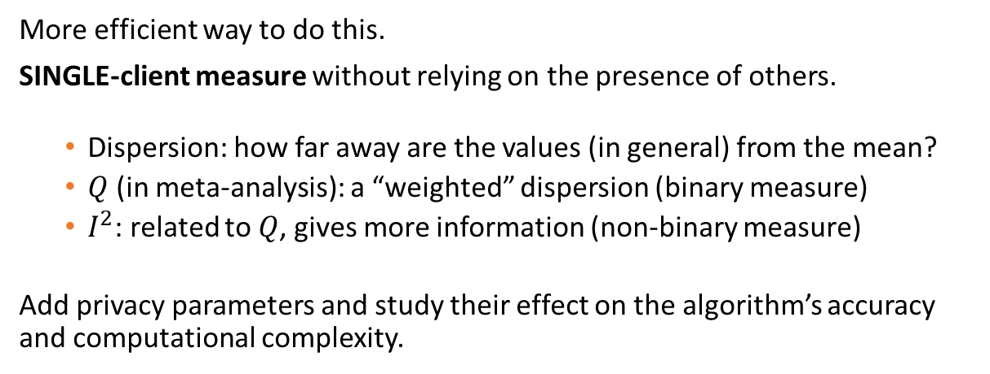
Improvements to FedACS
More efficient way to do this.
SINGLE-client measure without relying on the presence of others.
Dispersion: how far away are the values (in general) from the mean?
$Q$ (in meta-analysis): a “weighted” dispersion (binary measure)
$I^{2}$: related to $Q$, gives more information (non-binary measure)
Add privacy parameters and study their effect on the algorithm’s accuracy and computational complexity.

Slide 81
Reference (FedACS paper)
Z. Wang, Y. Zhu, D. Wang, and Z. Han. FedACS: Federated skewness analytics in heterogeneous decentralized data environments. In 2021 IEEE/ACM 29th International Symposium on Quality of Service (IWQOS), pages 1-10. IEEE, 2021.

Slide 82

Thank you for listening
Any questions?
Mary.P.Scott@warwick.ac.uk

